Slide 1

From Compliance to Excellence?
Literacy and Numeracy
What does the data tell us?

Slide 2
Tracking
Sample group – Ace 1 and Ace 2
Why?
- Top students and small group
- Likely to desire a HSC qualification
- Able to articulate concerns / issues / feedback (qualitative data)

Slide 3
Things to remember - stanines
Stanine scores
Stanine scores are derived from percentile ranks. Percentile ranks are divided into nine categories called stanines (short for ‘standard nine’) and the digits ‘1’ to ‘9’ are used as category labels

Slide 4
Stanines
https://pat-trc.acer.edu.au/pat-basics/video-what-are-stanines

Slide 6
Things to remember - How to log on?
Go to:
Oars.acer.edu.au/chifley-college
Log in names
CAPASENIOR MATHSANDSCIENCESENIOR
ENGLISHSENIOR TEACHANDLEARNSENIOR
LANGUAGESENIOR HSIESENIOR PDHPESENIOR
Passwords: CHIFLEY2770

Slide 7
Ace 1
Positive growth trends
Significant improvement in some areas

Slide 8
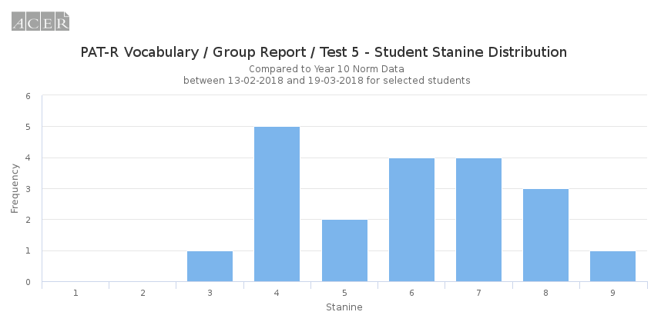
Ace 1 Vocab - Feb
20 students tested

Slide 9
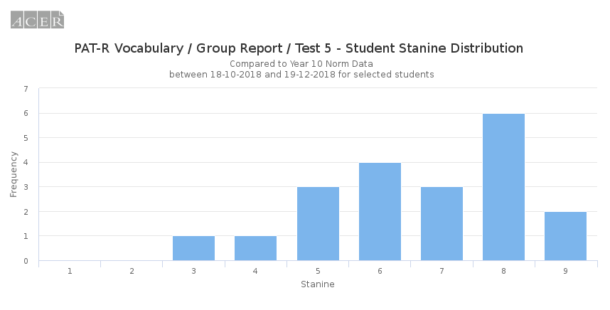
Ace 1 Vocab - Nov
20 students tested

Slide 10
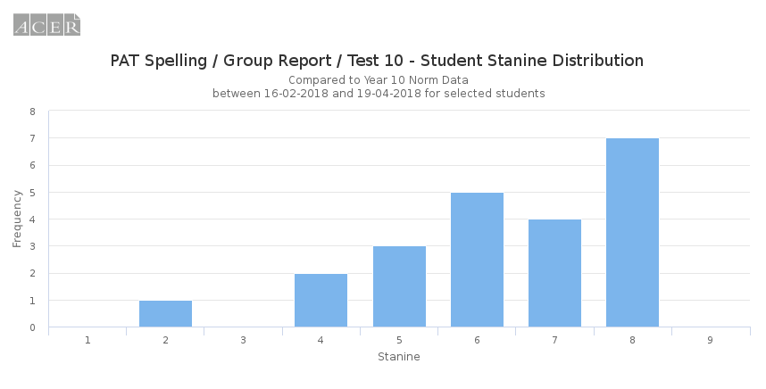
Ace 1 Spelling - Feb
22 students

Slide 11
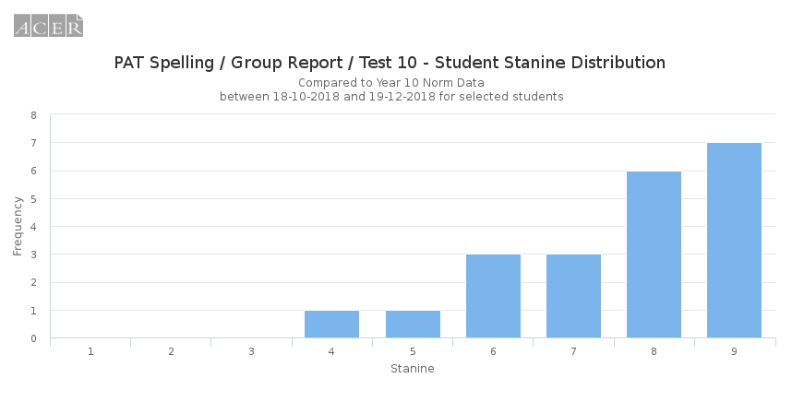
Ace 1 Spelling - Nov
21 students

Slide 12
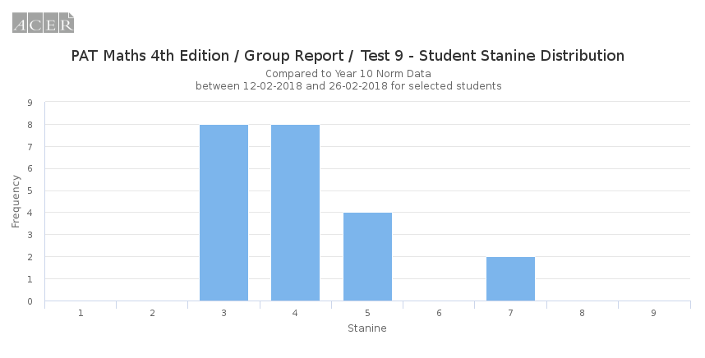
Ace 1 Maths - Feb
NB Test 9 – 22 students

Slide 13
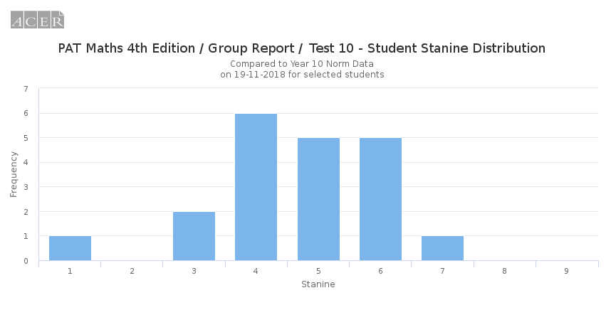
Ace 1 Maths - Nov
NB Test 10 – 20 students

Slide 14
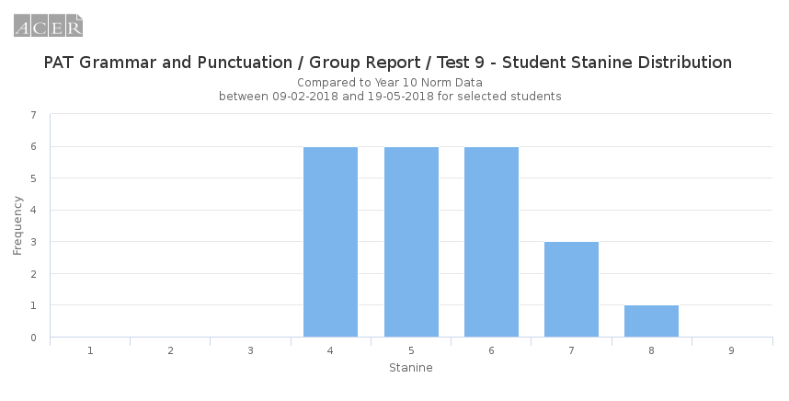
Ace 1 Grammar and Punct - Feb
22 students

Slide 15
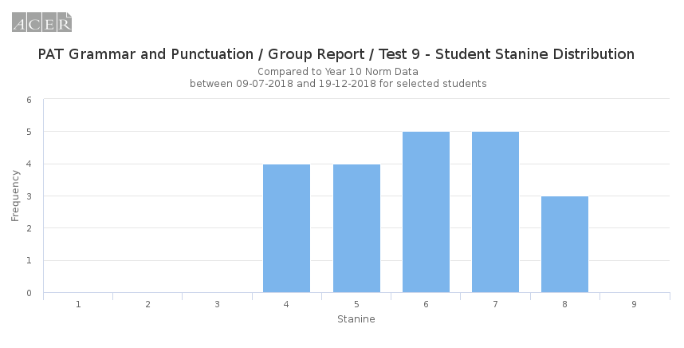
Ace 1 Grammar and Punct - Nov
21 students

Slide 16
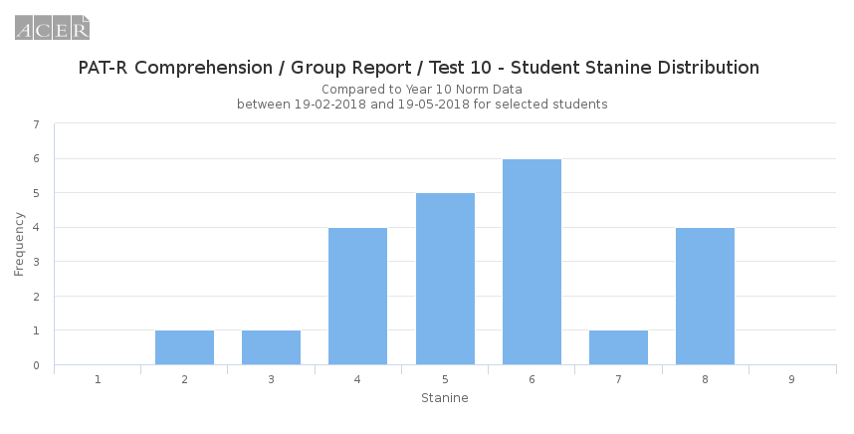
Ace 1 Comprehension - Feb
22 students

Slide 17
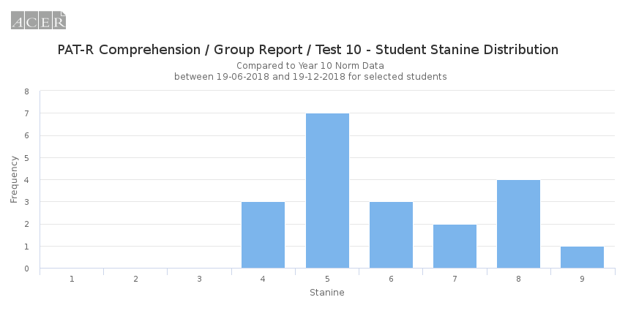
Ace 1 Comprehension - Nov
20 students

Slide 18
Ace 2
Some positive growth, though very inconsistent.
Some students have gone backwards.
Big drop in number of students completing tests.
Very reluctant to complete tests – students kept ‘disappearing” and needed much more supervision

Slide 19
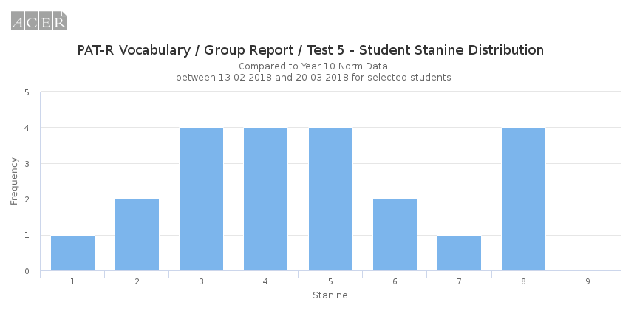
Ace 2 Vocab Feb
22 students

Slide 20
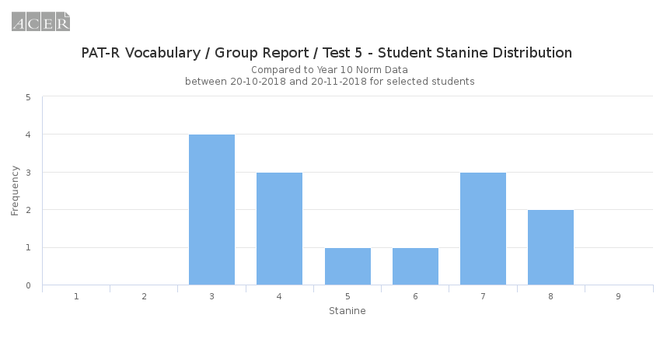
Ace 2 Vocab - Nov

Slide 21
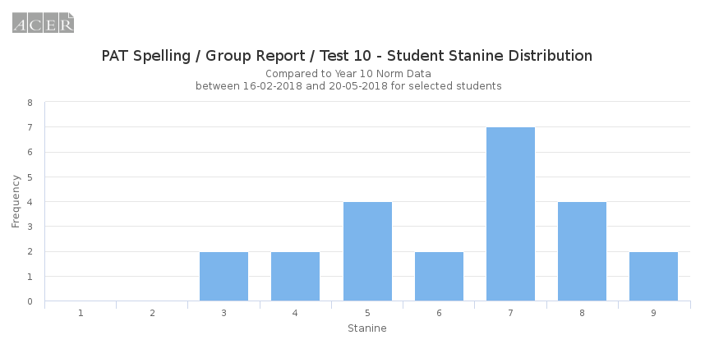
Ace 2 Spelling - Feb
23 students

Slide 22
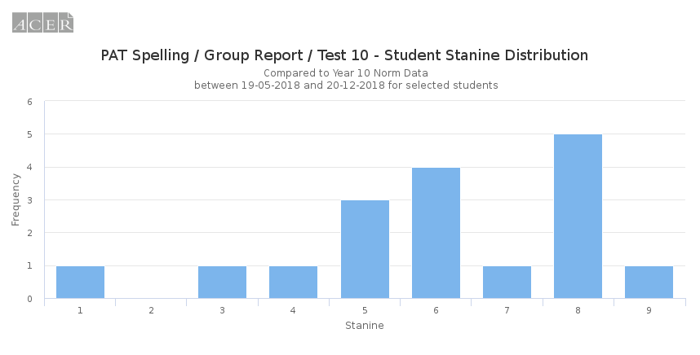
Ace 2 Spelling - Nov
17 students

Slide 23
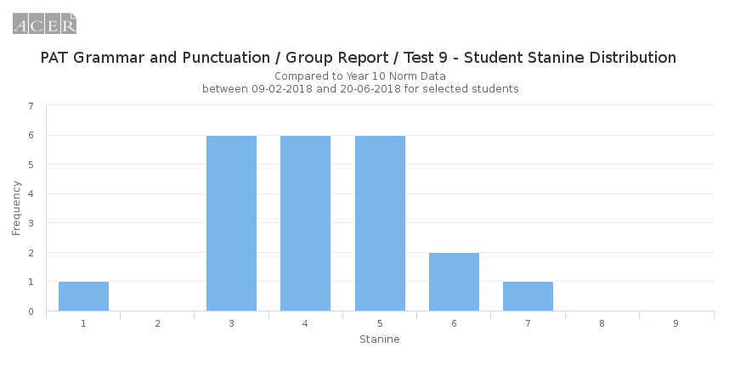
Ace 2 Grammar and Punct - Feb
22 students

Slide 24
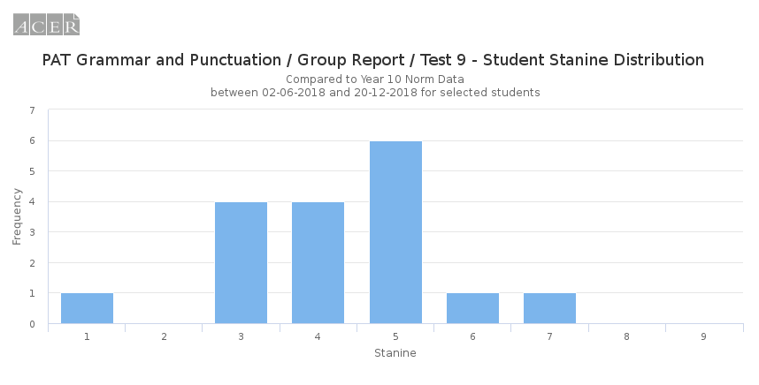
Ace 2 Grammar and Punct - Nov
17 students

Slide 25
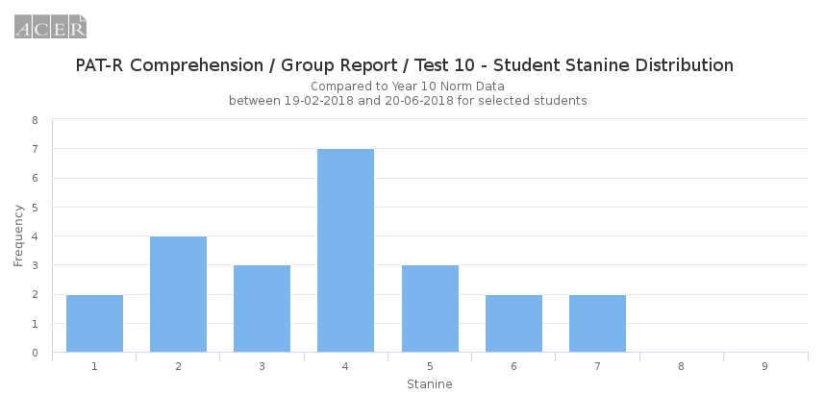
Ace 2 Comprehension - Feb
23 students

Slide 26
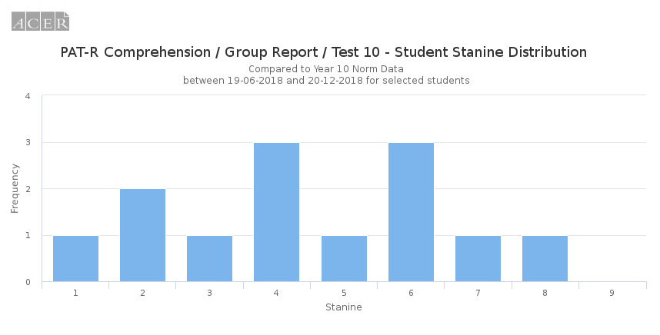
Ace 2 Comprehension - Nov
13 students

Slide 27
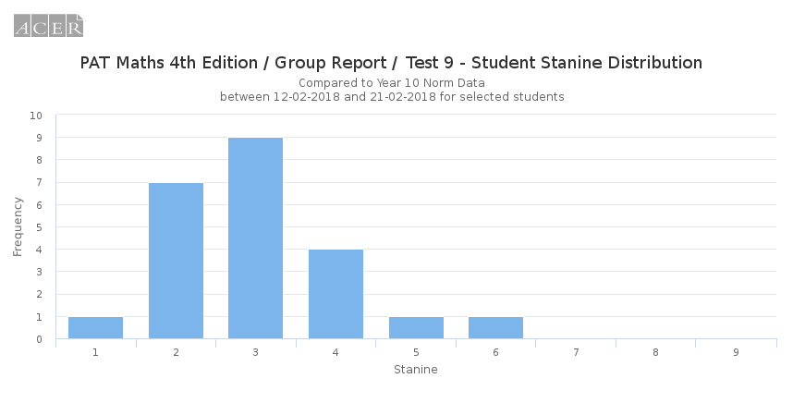
Ace 2 Maths - Feb
Test 9 – 23 students

Slide 28
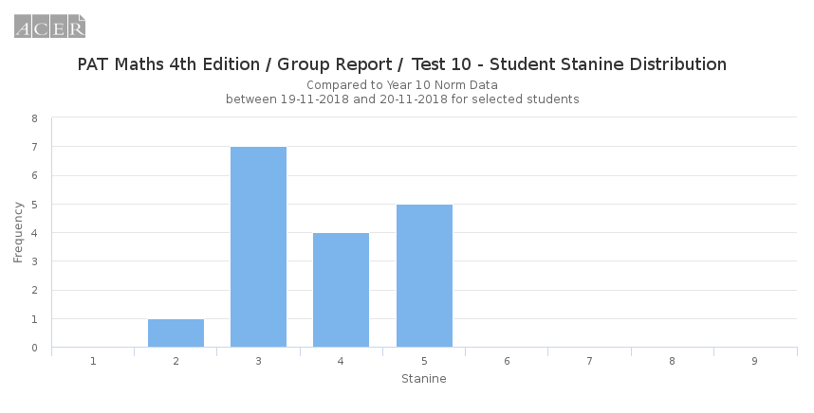
Ace 2 Maths - Nov
Test 10 – 17 students

Slide 29
Case Study – Grace Major
Grace Major – chosen as she was ranked 1st according to reports in Year 11.
Ace 1 / Advanced English / Ancient History / Modern History / Extension History / Society and Culture / Geography / Visual Arts -13 units
Consistent effort both in February and Nov
Would pass an online literacy and numeracy test
Stressed about online testing – found the process difficult and emotionally stressful.
Raises questions: How do we report on literacy and numeracy growth? Should we be doing this? How do staff know if students are improving?

Slide 30
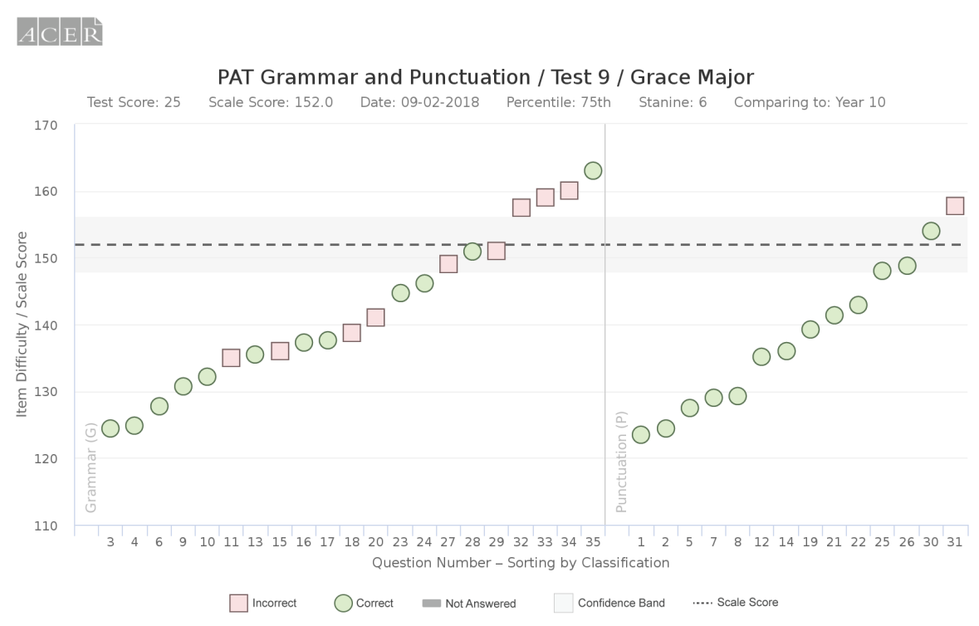
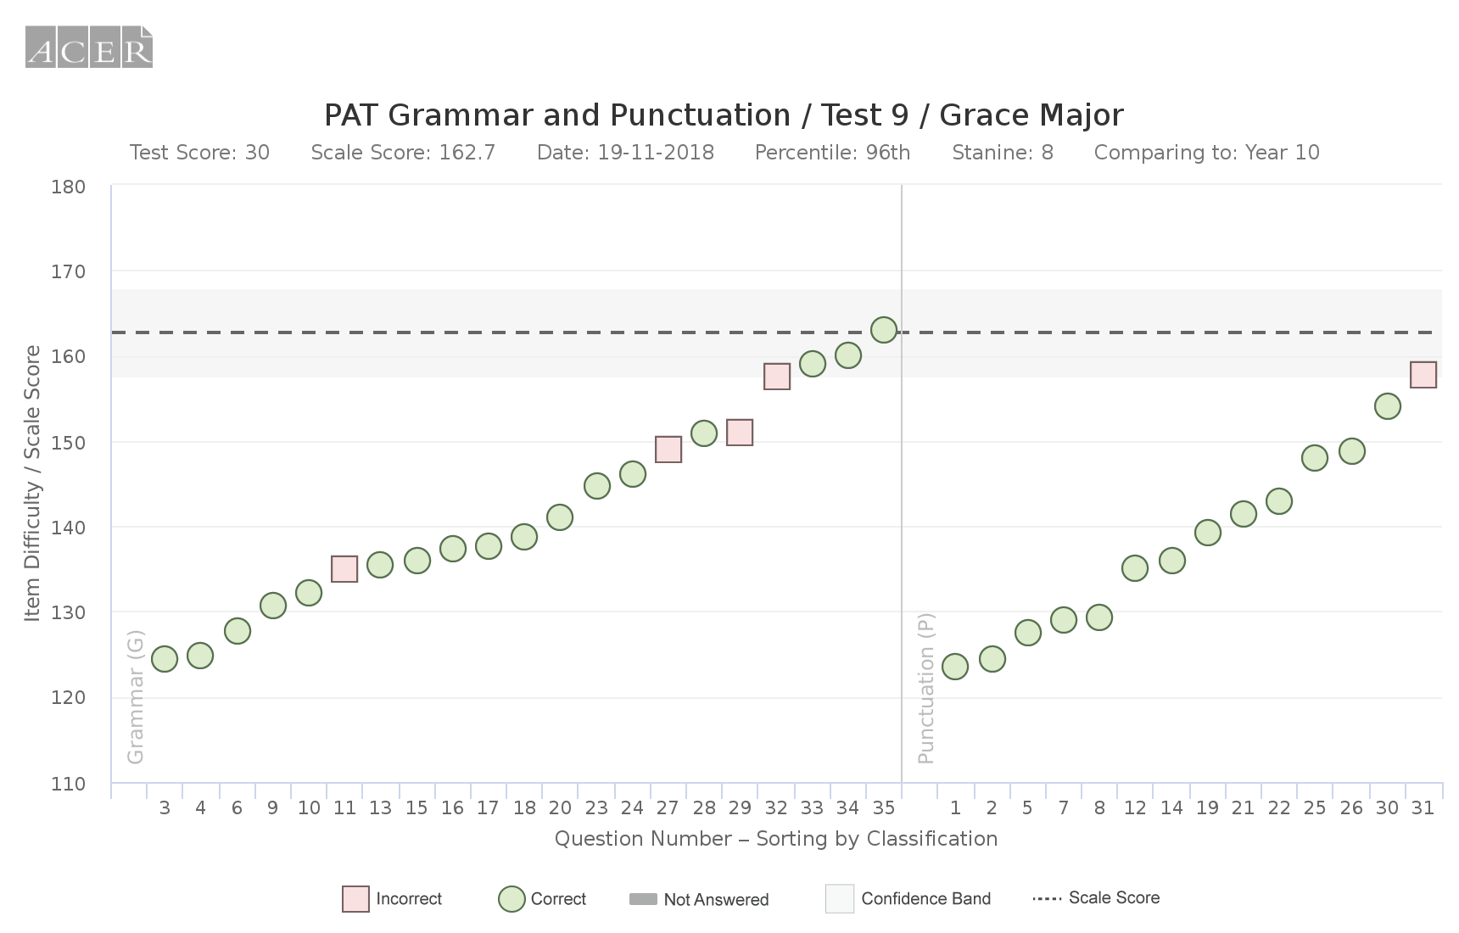
Grace Major – Grammar and Punc
Feb
We have the potential to create independent learning goals and targeted instruction to address these issues.
Nov
We can see a significant
Improvement but recognise that Grace is consistent in the questions that she
answers incorrectly.
Stanine 6 to Stanine 8

Slide 31
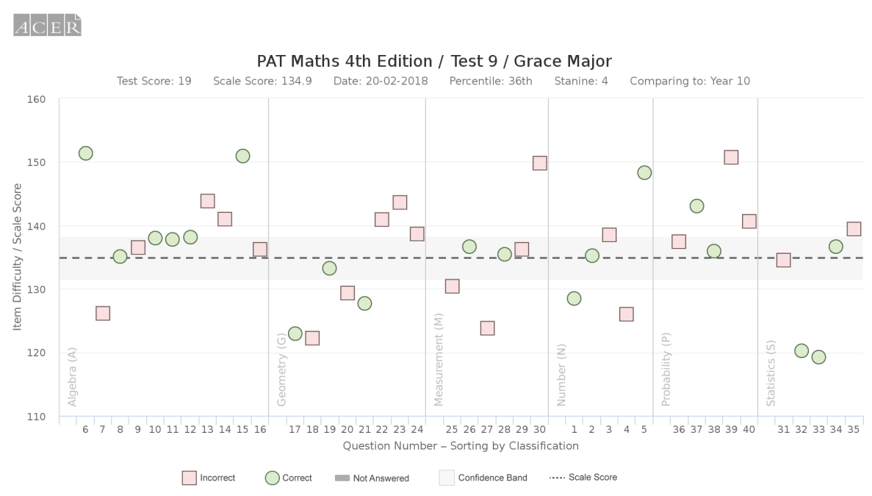
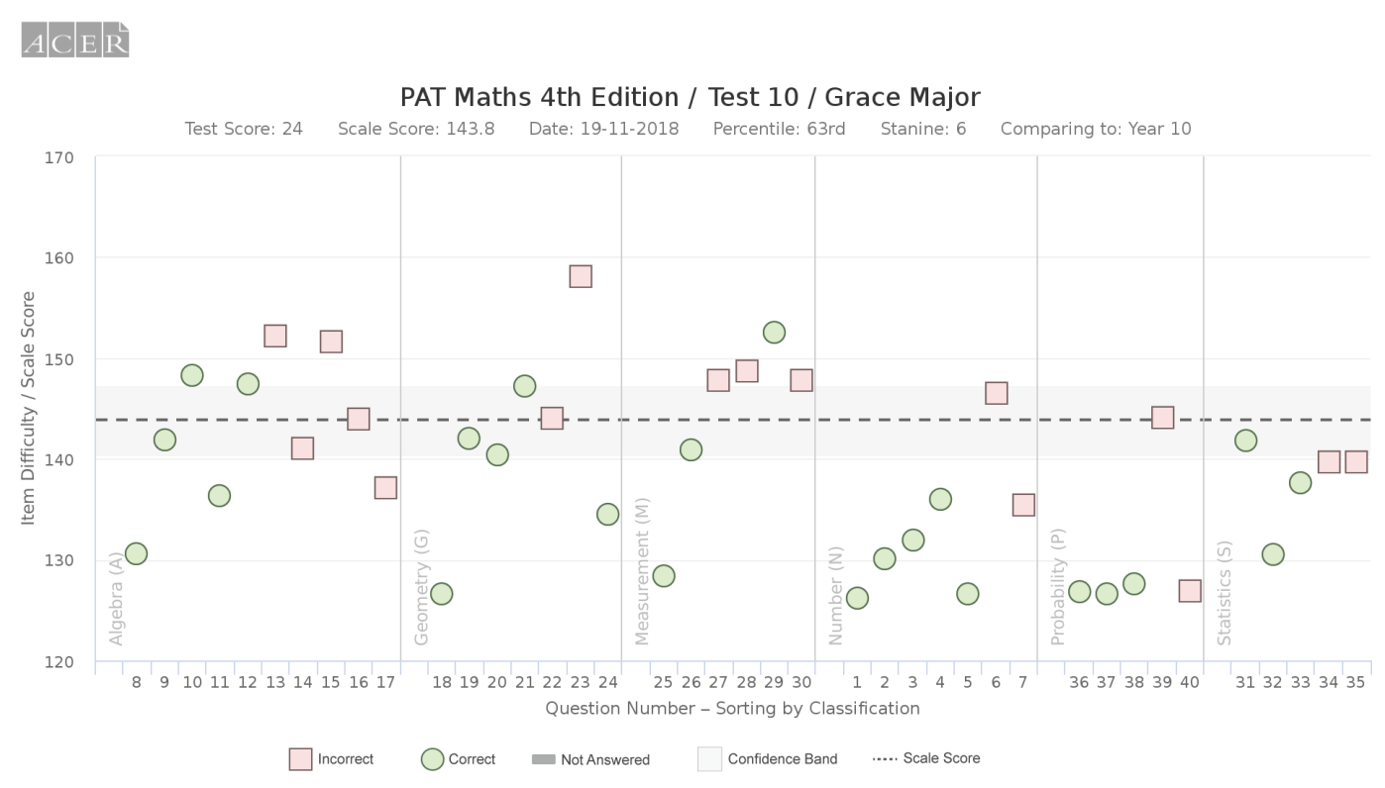
Grace Major - Maths
Feb
Again, we can see patterns and trends that suggests areas for development that will add most value
While the Nov test was harder, Grace still improved significantly
Stanine 4 to Stanine 6.

Slide 32
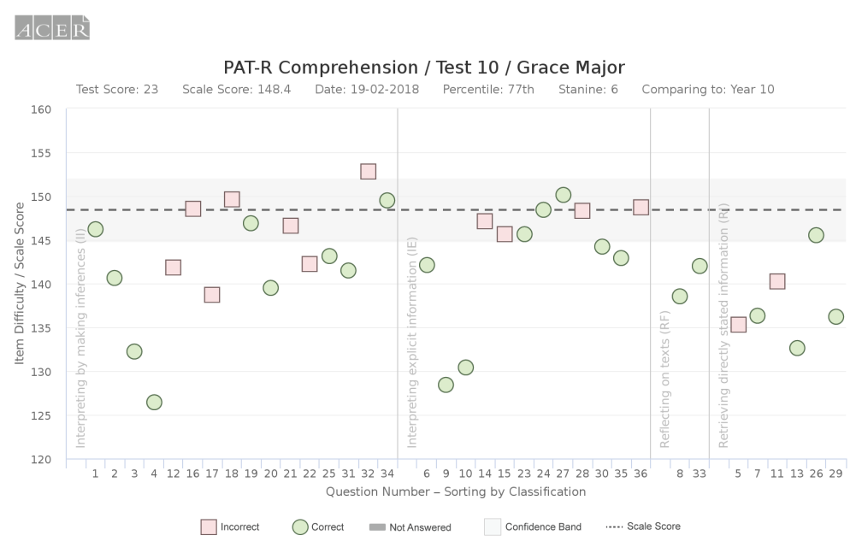
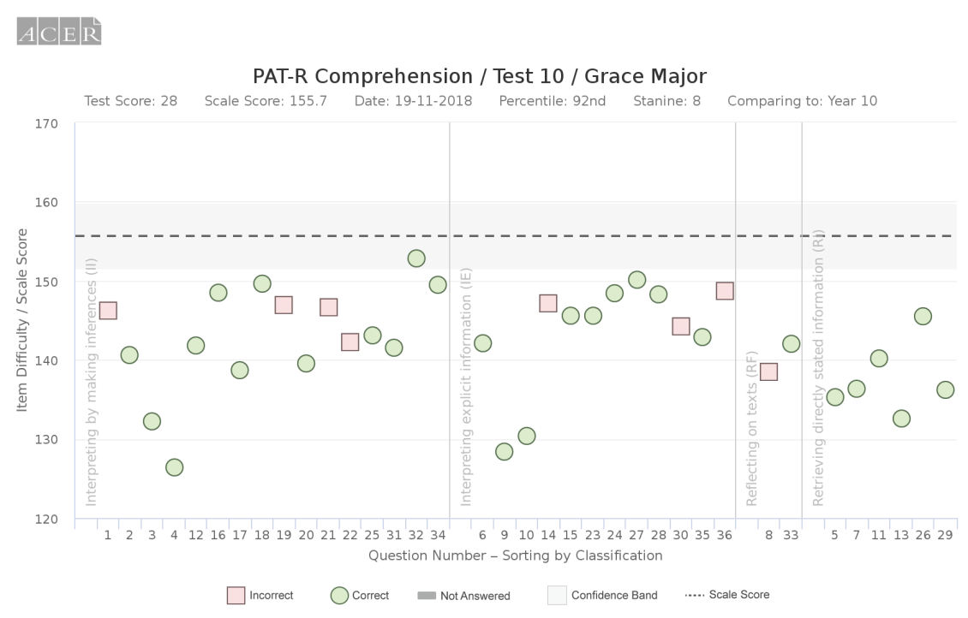
Grace Major - Comprehension
Patterns of incorrectly answered questions are still maintained, again suggesting key areas for improvement
Stanine 6 to Stanine 8 in Reading

Slide 33
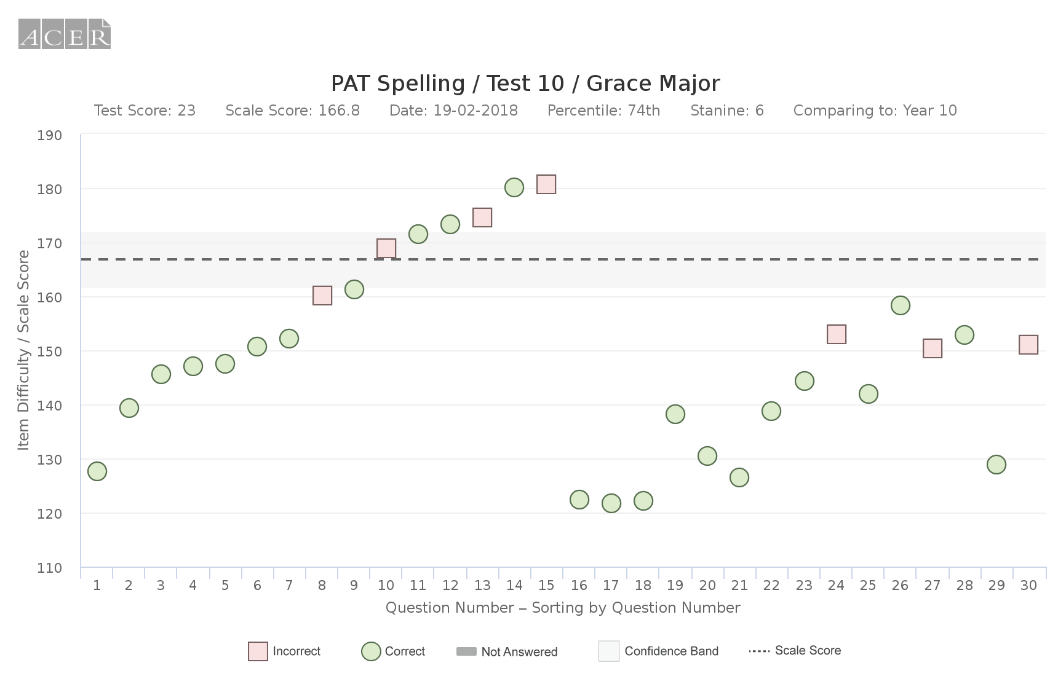
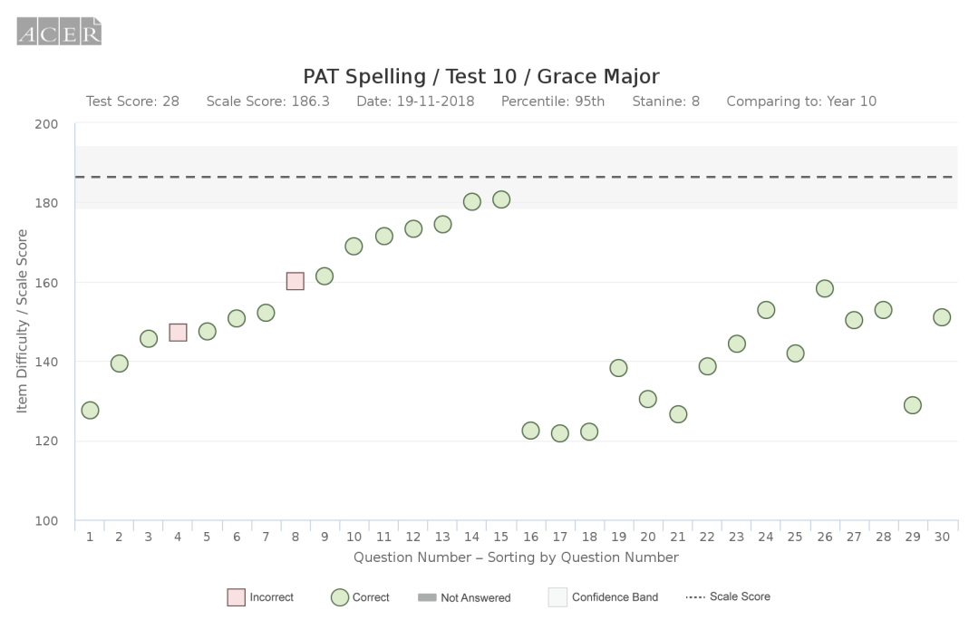
Grace Major - Spelling
Grace’s answers:
Question 8 - unparralelled
Question 4 –
preferrably
Grace is struggling with doubling up and dropping letters
Stanine 6 to 8 in spelling. One new mistake in Nov. One consistent mistake between both exams.

Slide 34
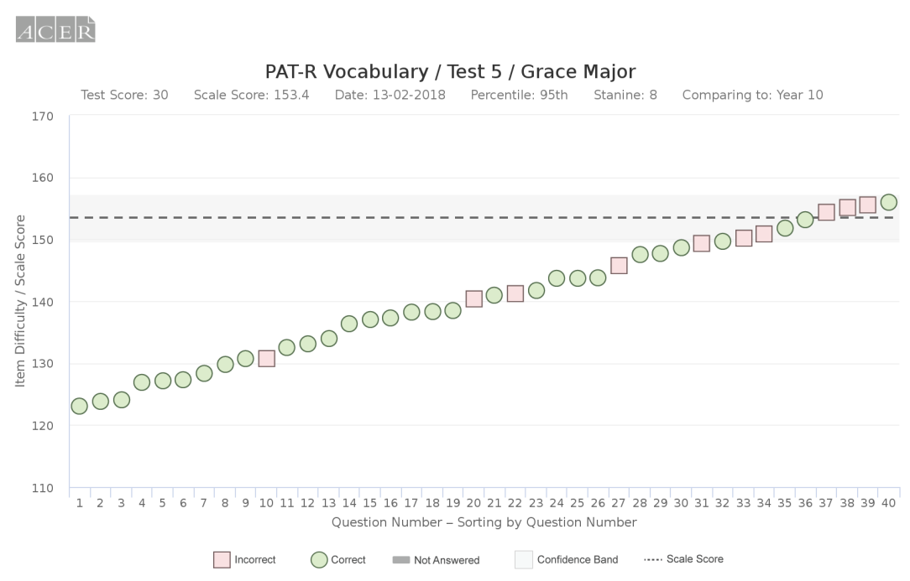
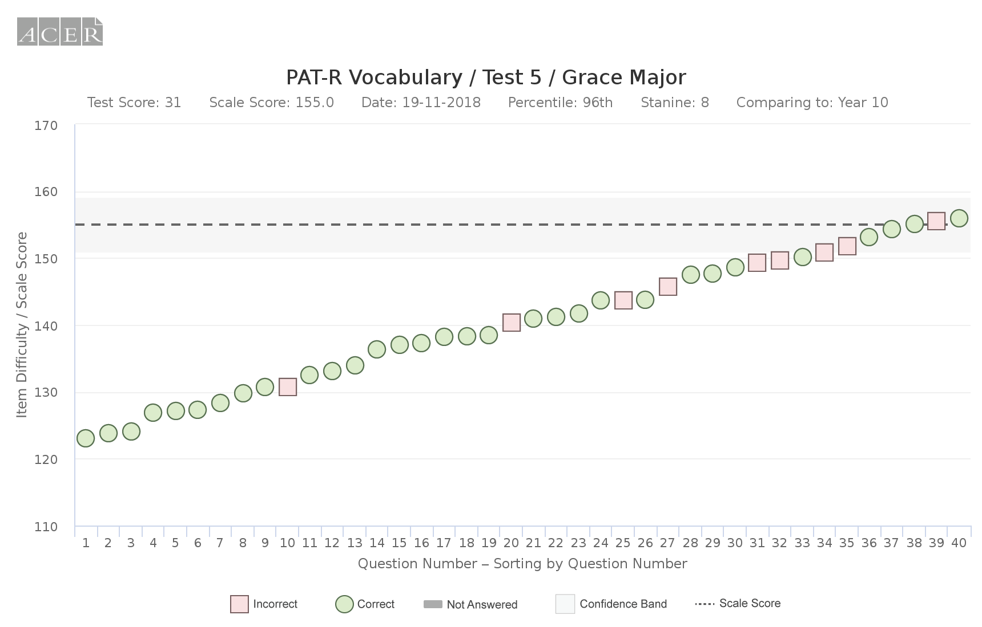
Grace Major - Vocab
Stanine 8 in both tests.
Very slight improvement.
lots of consistent incorrect
Answers across both tests

Slide 35
Grace Major - Conclusions
Grace has had significant natural growth.
Imagine what she could do with targeted instruction and differentiated interventions.
Grace is likely to be one of our top students, but there are still areas that need to be developed AND she is not accessing the opportunities to address these consistent problem areas in class.
Imagine her improvement if we could integrate explicit and targeted literacy and numeracy within our content delivery.
We can see patterns and trends in strengths and weaknesses
Imagine if we could embedd processes in the school to identify and use student strengths and weaknesses to inform instruction
Testing data provides useful information for students, parents and teachers.
Imagine if we could develop parental reporting systems to include testing data

