Slide 1
Hands on Technology – Fusion 360 (Autodesk)
Killara High School

Slide 2
Tell us about your training and development event
An introductory course to the product Fusion 360. Run by the Institute of Industrial Arts and Technology Educators.
Fusion 360 (Ultimate) is the first 3D CAD, CAM, and CAE tool of its kind that connects your entire product development process in a single cloud-based platform that works on PC, Mac, and mobile devices.

Slide 3
Key Terms
Computer-aided design (CAD)is the use of computer systems to aid in the creation, modification, analysis, or optimization of a design. CAD software is used to increase the productivity of the designer, improve the quality of design, improve communications through documentation, and to create a database for manufacturing.

Slide 4
Key Terms
Computer-aided manufacturing (CAM) is an application technology that uses computer software and machinery to facilitate and automate manufacturing processes. CAM is the successor of computer-aided engineering (CAE) and is often used in tandem with computer-aided design (CAD).

Slide 5
Key Terms
Computer-aided engineering (CAE) is the broad usage of computer software to aid in engineering analysis tasks. It includes finite element analysis (FEA), computational fluid dynamics (CFD), multibody dynamics (MBD), durability and optimization.

Slide 6
What did you learn?
The basics of the Fusion 360 product.
Like all CAD courses you need time on the product to really understand it.
In our faculty we have progressed from two PTC products (Pro Desktop and Creo) and are now looking to transition to Fusion 360.
We believe it will be easier for students to learn.

Slide 7
How did it Change your practice?/What does it look like in your school?
Access for students is increased significantly. They can use it at home.
It has changed the rollout of the software across school.
It can be used across multiple subjects such as Design and Technology, VET subjects, Industrial Technology and Engineering Studies. It could be used in the Visual Arts space.
Like all CAD software we are able to utilise the following technologies to manufacture products. These include:

Slide 8
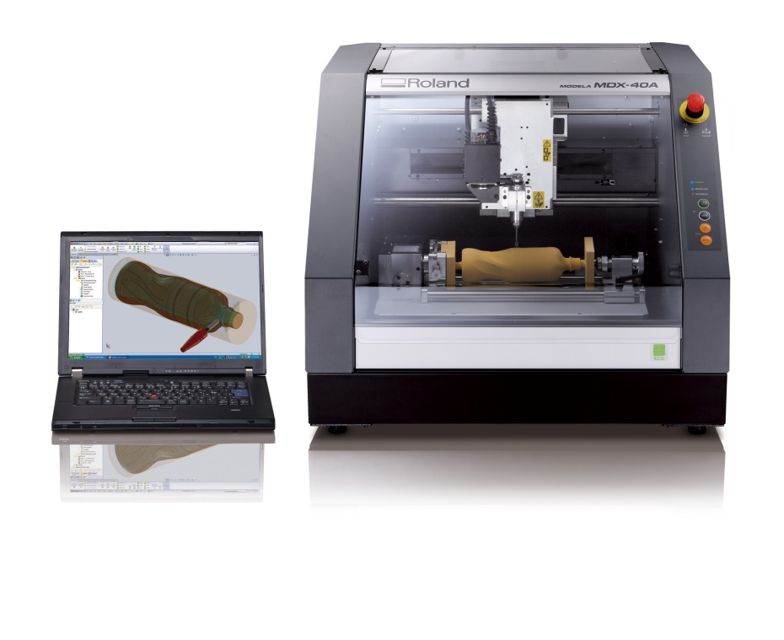
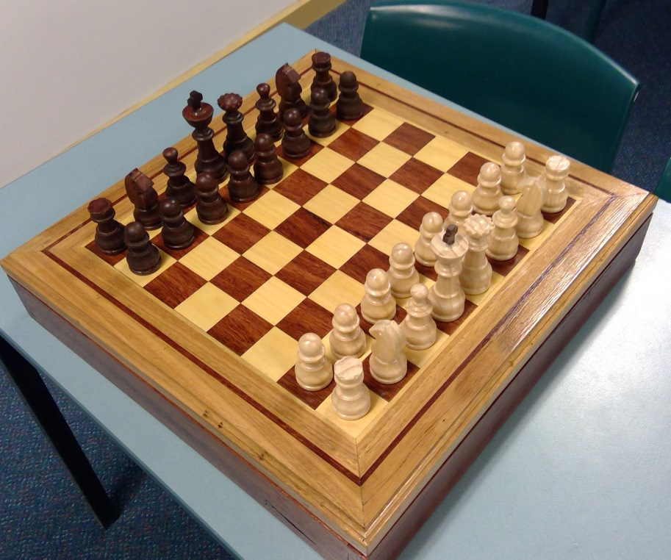
3D Milling Machine

Slide 9
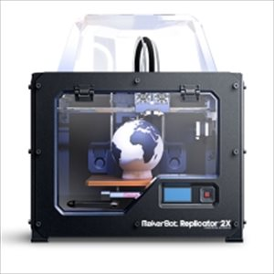
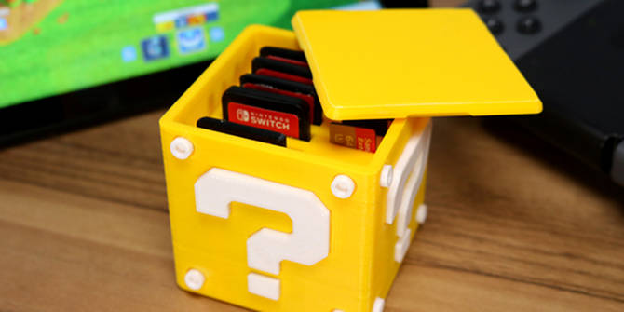
3D Printer

Slide 10
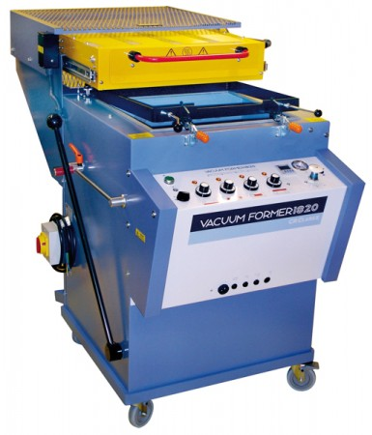
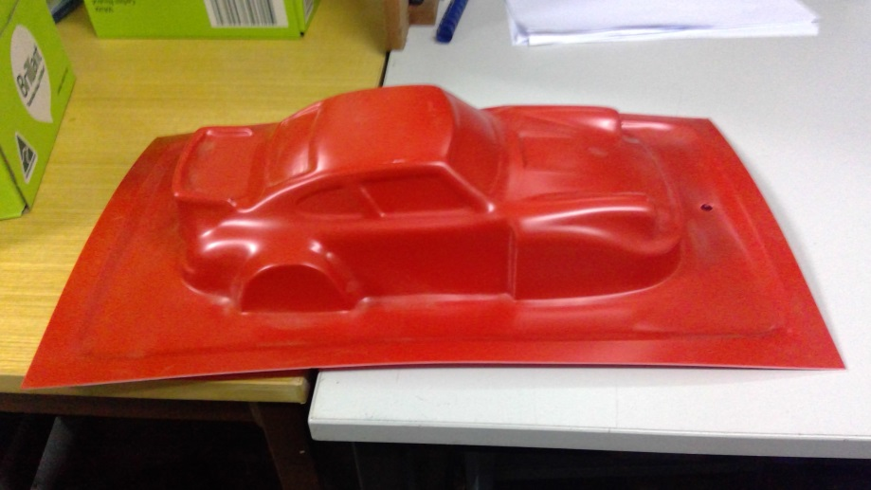
Vacuum Formers

Slide 11
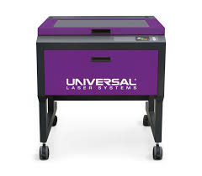
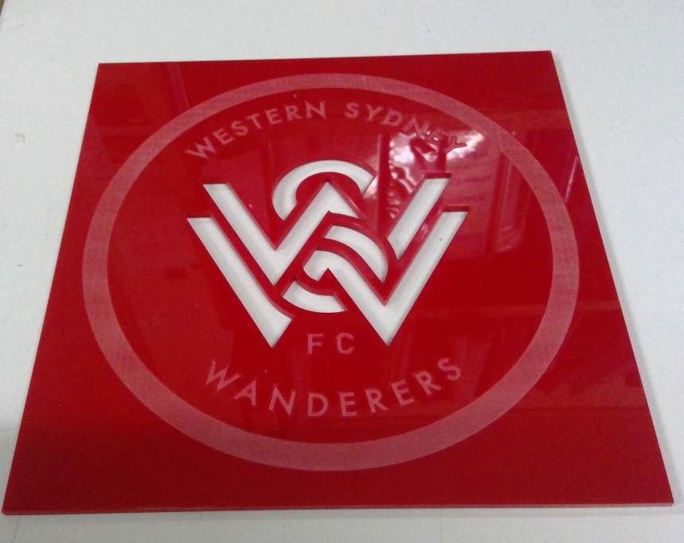
Laser Cutters

Slide 12
What were the outcomes for the students?
Students have access to State of the Art software.
They can easily access their work at home.
The Software is free to students.

