Slide 1
Connecting With
Our Students
Presented by Nikki Beaton

Slide 3
04
Give their voice a platform
Tap into their passions
01
03
Make students the experts
Connect to their world
02

Slide 4
Hook the Students
The attention span of a teenager isn’t very long – you need to get their attention and keep it by developing lessons that get them to “buy into” the content
4
Tackle problems together
2
5
3
1
Rock the first 5 minutes
Show them you care
Bury the past
Student Culture

Slide 5
Rock the First 5 Minutes
The premise here is that these first few minutes before class will be used as a warm-up. Students need and deserve a bit of breathing room to be themselves at the beginning of a class before we begin to put expectations on them.
Chat about what they did the night before, what they’ve been reading, or the latest news that intrigued them. Answer their questions and listen to their stories. The possibilities for casual connection are endless. Before you know it, the first five minutes are up and everyone’s ready to work.

Slide 6
Rock the First 5 Minutes
Chat to the person next to you and discus……..
What do you do right now?
Could you make a few changes?
Is your room inviting?
Do your students feel safe?
How do you interact at the beginning?

Slide 7
Share Your Life
This is one of those classroom engagement strategies that can work wonders if you do it right. From time to time, relax and open up a little. Choose some stories to tell about yourself to show students that behind the mask of professionalism is someone just as human as they are.
Fostering connection and engagement can take time. Keep at it and reinforce the openness you’re willing to demonstrate. After a time, students will feel much more comfortable talking about themselves in an environment you’ve made safe for them.

Slide 8
Show Them You Care
If there is one student need that tops their list, it’s the need to know their teachers care about them. Unfortunately, this idea can also often be misunderstood. This is mostly because teachers fear the risk of overstepping certain boundaries, and rightfully so.
This is what showing students you care does mean:
listening actively
valuing their opinions
greeting and talking to them
having patience
honouring their individuality
This is the kind of attention that lets students know they matter. The academic stress and social pressure that are a part of being in school can often leave little time for celebrating the moments that make us feel human and special. You are the perfect person to provide what’s missing.

Slide 9
Tackle Problems Together
We’ve talked before about the importance of letting students know they aren’t alone. Problems in and out of the classroom sometimes need a collaborative approach. The teacher’s role today has moved away from being the gatekeeper of all knowledge and solutions. We are now guides, mentors, and supporters of the quest for discovery in learning, and also self-discovery.
Our position is still a vital one in that students thrive on collaboration and teamwork. Show a willingness to work through problems with them as partners and as part of an unbeatable team

Slide 10
Bury The Past
There is a danger of yearning for the days of yore when classrooms (and students) were very different from what they are like now. The danger we face is in simply missing out.
When we stay stuck in the past, we can’t put an eye on the present and the future. We risk shunning learning opportunities and teachable moments as we yearn for a simpler time before technology changed the game. We can lose sight of the creativity and brilliance shining in our kids right here, right now.
This is a time for discovering the wonder and the challenges of what is happening now in education, and in the exponentially changing world. Embrace it, and it will embrace you back.

Slide 11
Survey of teenagers & teachers…
Students are under so much more pressure than we ever were to succeed, to be the coolest, to be the funniest, to be accepted – everything they do is broadcast through social media.
They have to be “on” all the time – how many likes did their last post get?
Home life, extended family, peer pressure, money, food, no clean clothes, babysitting their siblings, looking after grandparents.
They need to have an environment where they feel accepted and understood – not judged, but a place they can make mistakes, have an off day and that’s OK.

Slide 12
Empowering the students with resilience and strategies to help them cope with what is happening right now.
Helping them understand that the way they are feeling is temporary and that their current mood and actions shouldn’t define their overall personality.
It’s OK to have a bad day – but taking it out on everyone else is not acceptable. Give them the time and space to deal with the situation – help them with strategies – their will be NO learning if they are challenged and you don’t acknowledge their perception of the situation.
Mental Health
Anxiety/Depression

Slide 13
Lack empathy & compassion
Ridicule them
1
8
Not to accept their apology
Humiliate them in front of their peers
2
7
Things we do that alienate the students
Highlight what they don’t know
Condescending tone and body language
3
6
Always teaching the same way – eg from a textbook
4
5
Attack them when they walk into the room

Slide 14
Student Culture
Our students live in a different world today. Instant entertainment and social connection are the cultural norm for them. We know they tend to gravitate towards certain digital stimuli as well.
Because of all this, we face a new kind of student. As an educator, it’s important to familiarize yourself with the habits and mindsets that define our digital generation.

Slide 15
Student Culture
Fortnite
Bottle Toss
Floss
Instagram
Snapchat
Minecraft
Fake Text
Classroom Ideas?

Slide 16
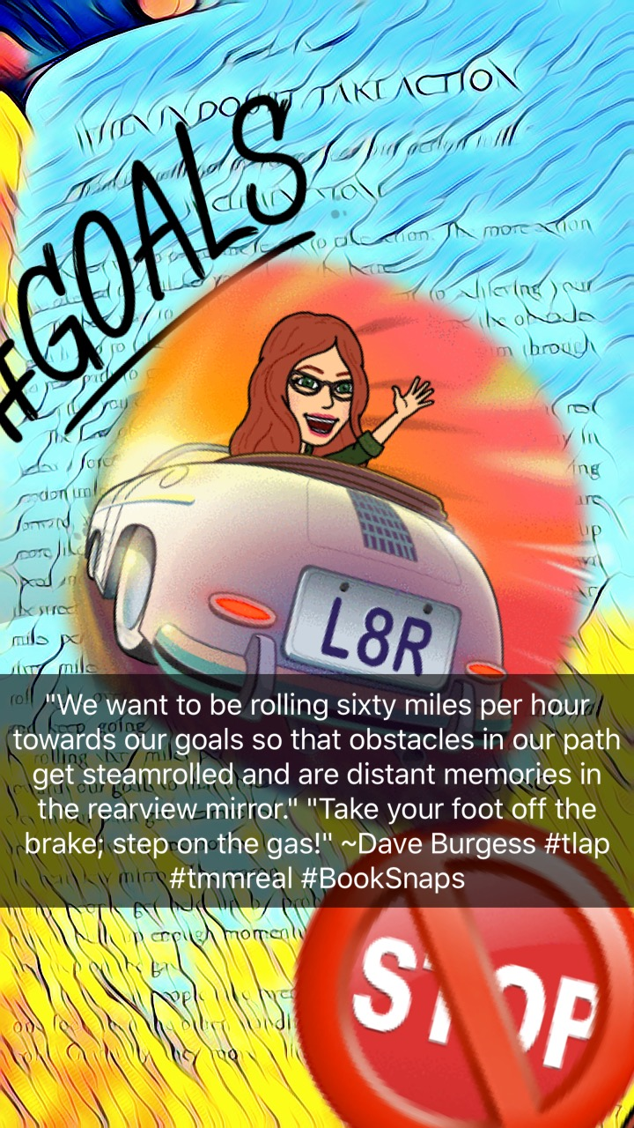
#Booksnaps Tara Martin

Slide 17
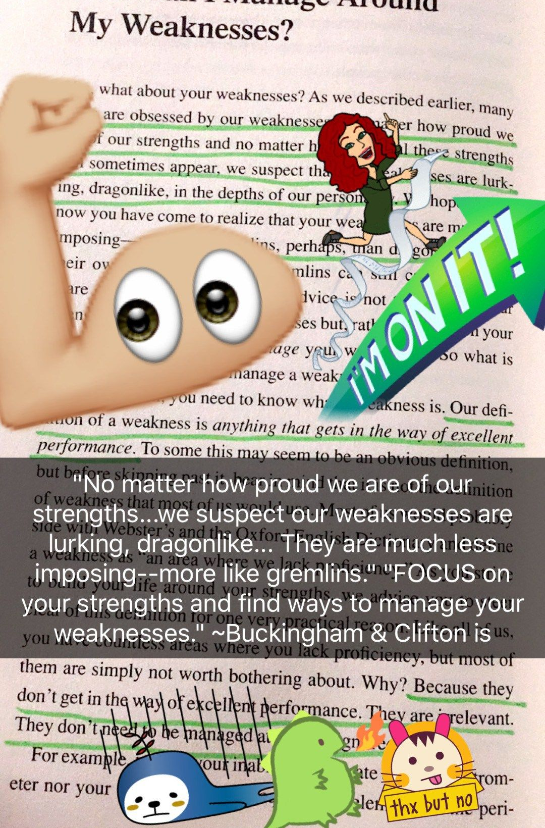
#Booksnaps Tara Martin

Slide 18
Bottle Toss – Maths Example

Slide 19
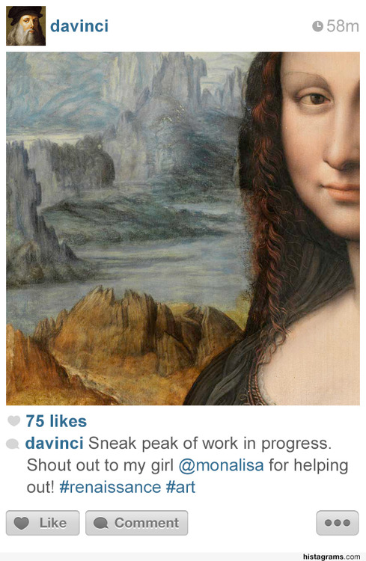
Instagram

Slide 20
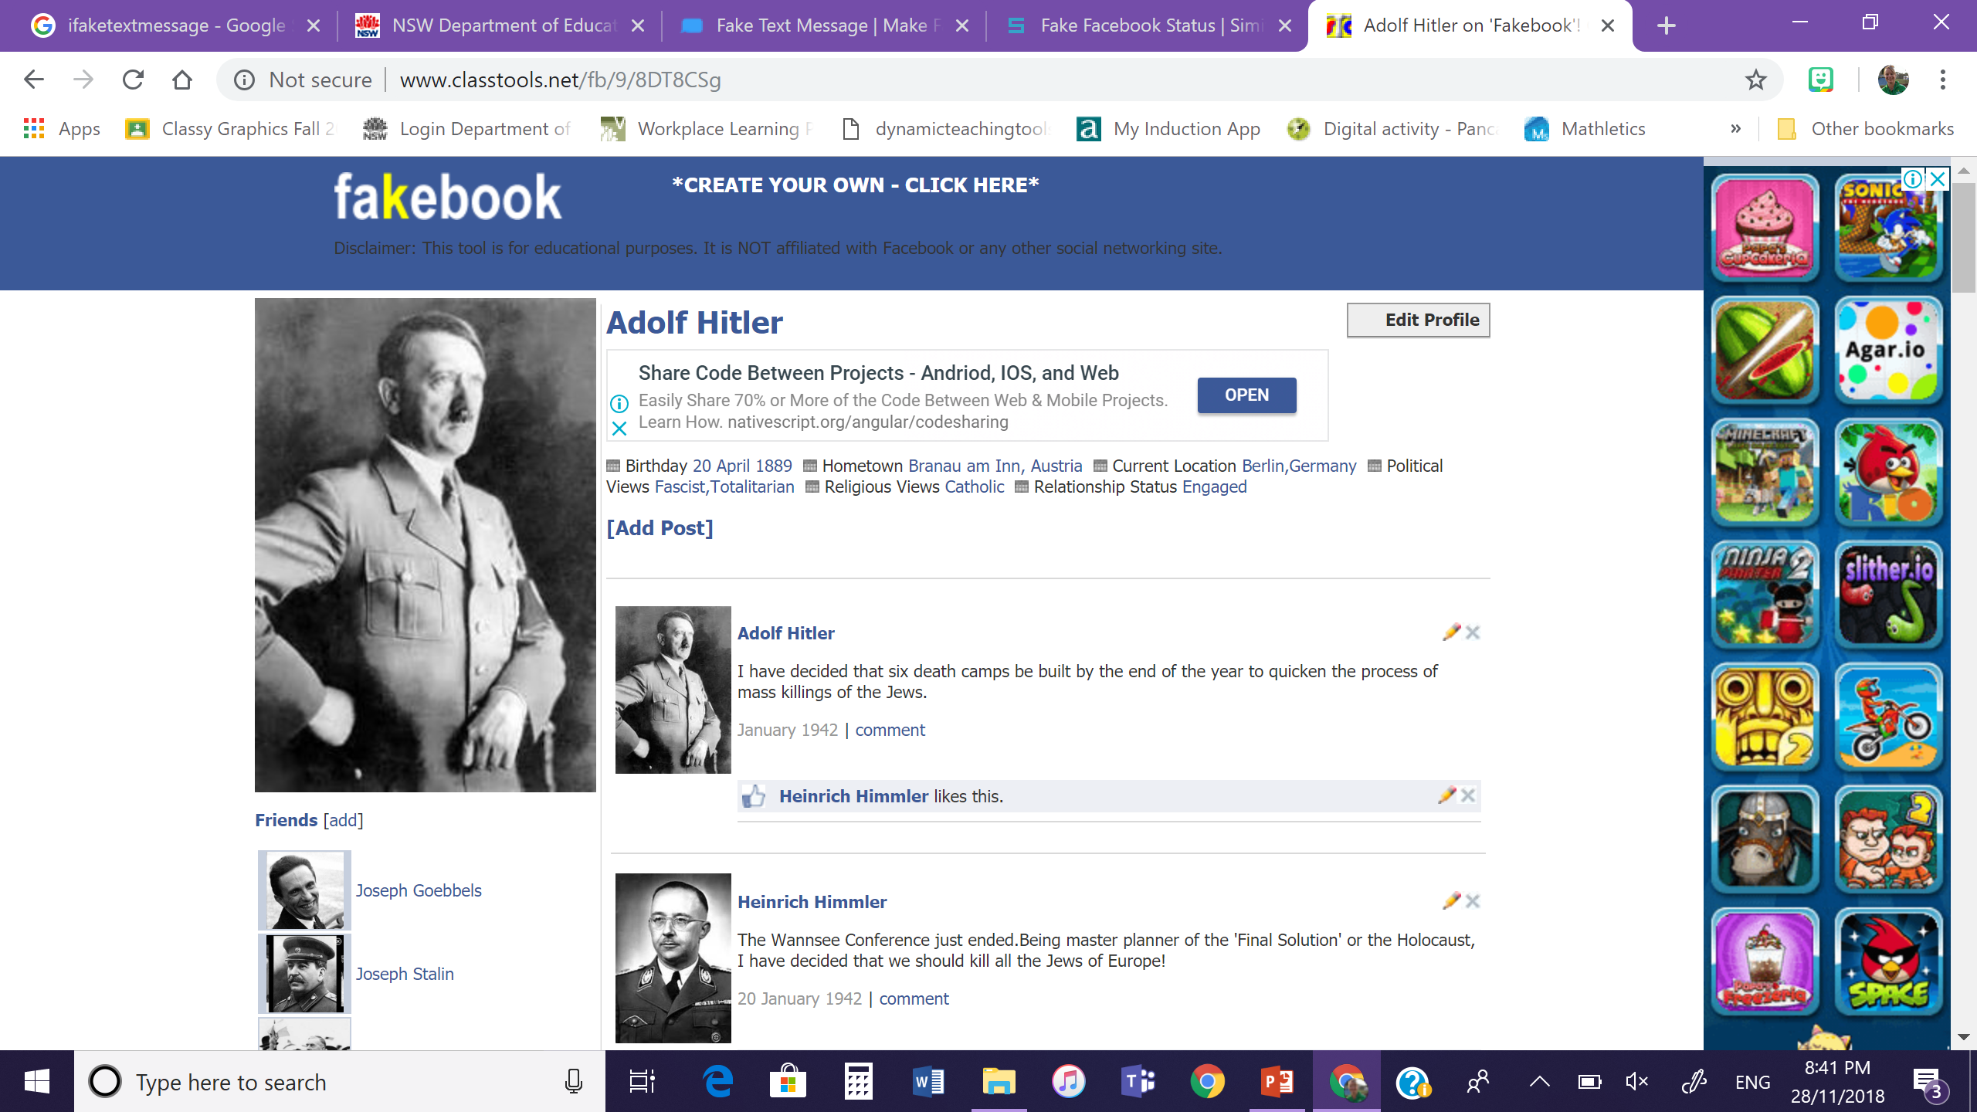
Fake Facebook Profiles
Characters in a book
Famous Historians
Inventors/Scientists

