Slide 1
TAMING THE T-REX IN YOUR CLASSROOM

Slide 2
HAVE YOU EVER…
… had a problem in your personal life?
… felt like you couldn’t talk about that problem with anybody?
… found that problem overwhelming?
… struggled to think about anything other than that problem?
… brought that problem to work with you?
https://play.kahoot.it/#/?quizId=a4c6bdd6-d740-4d88-8a7f-81062c65272b

Slide 3
YEP… I’VE BEEN THERE

Slide 4
YEP… I’VE BEEN THERE… AND SO HAVE THEY

Slide 5
I WISH MY TEACHER KNEW THAT I…
… get stressed when I have too much work
… am only starting to know English and I do not understand everything, but I try to understand
… don’t listen to my music with my earphones in, I just like my ears stuffed
… work better if I have music in my ears
… can’t arrive on time to my classes and there are too many assessment tasks due at the same time
… am shy and more comfortable when I am listening to music; I have ADHD and I can’t sit still, no matter how hard I try; Id like more help and support in class
… need more help with my work because it takes a bit to process

Slide 6
I WISH MY TEACHER KNEW THAT I…
… I don’t understand some classes; I have bad days; I struggle most days; my stress and my problems affect my learning
… really do struggle and that assignments are killing me at the moment; there’s too much pressure
… am struggling to understand in my classes
… how much I struggle; how many bad days I have; that I can’t focus anymore; that my problems affect me and my learning
… am struggling with all my subjects and feel so much pressure from my parents
… struggle with school stuff & in general family stuff
… don’t understand, and I don’t like being put on show or having too much attention
… have autism
… try to go to school, but putting me down isn’t helping
… am too busy to do homework every day

Slide 7
I WISH MY TEACHER KNEW THAT I…
… have anxiety and depression and how difficult it is living with that
… am capable of doing good things in my life
… am a good student with great dreams
… have 7 siblings
… am really busy at home; I cant always focus in class and I need some more help
… need more help
… don’t know how to study
… am busy after school; I can’t do homework on top of assignments and studying
… don’t like exams and studying
… don’t know who I am
… hate talking in public & become really anxious and self-conscious whenever I read; I doubt myself incredibly

Slide 8
I WISH MY TEACHER KNEW THAT I…
… sometimes I don’t understand what we’re learning in class and I’m too scared to ask for help
… am worried that my home life (duties, siblings, environment) will negatively impact my HSC and there is little to nothing I can do to fix it & neither can my teachers
… hate being labelled as “smart”, “top achiever” etc. Because people will set high expectations for me. I want to be seen as ME and go at my own pace
… don’t want competition; school isn’t about that, it makes people feel like they have failed
… have terrible social anxiety, so I prefer talking after class

Slide 9
IT FOLLOWS THEM TO CLASS…

Slide 10
1 BRAIN, 4 PARTS – (IF WE OVERSIMPLIFY IT)
#4: Cortex – The Learning Brain
Empathy, self-control, literacy etc
#3: Limbic system – The Mammalian Brain
Emotional responses
#2: Cerebellum – The Movement Brain
Co-ordination, movement, the ability to sit still
#1: Brain Stem – The Survival Brain
Heart rate, breathing, fight, flight or freeze response
Notes:
Brains 1 & 2 → the reptilian brain → if a lizard can do it, brains 1 & 2 are responsible for it. Should be noted, however – sitting still is actually a very complex task – it takes 50% of the cortex to sit still. So if a student is focus on trying to sit still, learning anything is going to be that much more difficult.
Brains 1, 2 & 3 → the mammalian brain → can the dog do it? If so, it’s in brains 1, 2 & 3 – the dog experiences emotions, can respond to tone, simple facial expressions, body language. Can’t talk or learn to read a book.
Brain 4 – most complex and takes the longest to develop and mature. When does it develop and mature? Depends on two main factors – gender and birth order. Girls mature between the ages of 18 and 24 – firstborn child, closer to 18. Not first born, closer to 24. Boys mature between the ages of 28 and 32 – first born child, closer to 28. Not first born, closer to 32. Can explain the intricacies and the why over morning tea if you want, but no time right now.
Telling you this to pint something out – the vast majority of our students have immature brains – it is actually physically impossible for them to think like us, reason like us, understand what we understand the way we understand it – they simply do not have neural pathways available to them. So something that is logical and makes perfect sense to you is physically impossible for them to understand.

Slide 11
THE NEUROSEQUENTIAL MODEL
The brain develops from bottom to top
The brain works from bottom to top
Rex is in control – the reptilian brain is the boss
You have to meet the needs of the first 3 brains before brain 4 comes on line

Slide 12
LET’S TALK ABOUT REX, BABY…
The Reptilian Brain – concerned with survival
Neuroception – not conscious, like perception
Doesn’t speak or understand language
No logic
Can’t be reasoned with
In charge
Notes:
The Reptilian Brain – concerned with survival
Neuroception – not conscious, like perception – 6th sense – not always correct, but always worth acknowledging
Not too bright – left over from our cave man days → controls freeze, fight or flight and even that is not overly successful – 75% of people freeze, 10% of people run (but most into the danger rather than away) and 15% of people fight
Doesn’t speak or understand language
No logic
Can’t be reasoned with
But Rex is in charge – he’s the boss, and if he is online, nothing else is going to happen – he’s not capable of anything else.

Slide 13
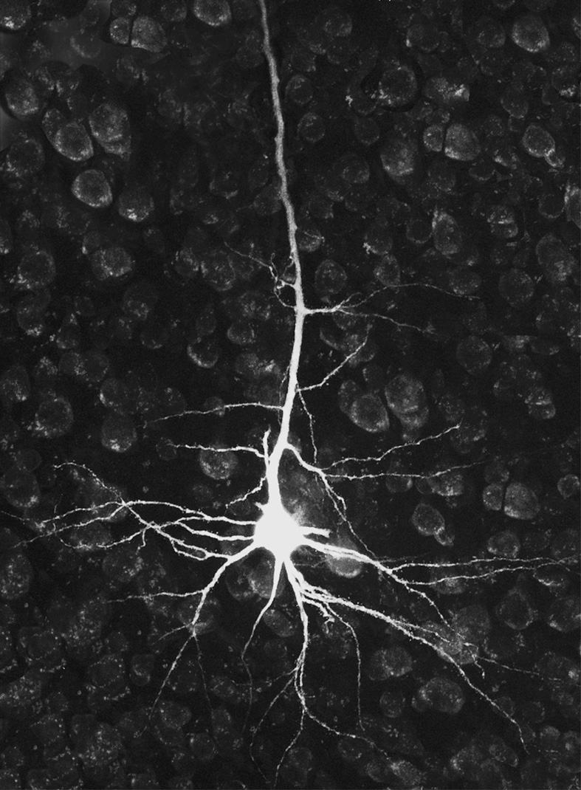
NEUROGENESIS
Neurons are “learning pathways”
We are constantly forming new ones – you are, right now
Neurons form
Synaptic connection forms
Myelination
Notes:
Neurons – dendrites, axon, synapse
When we learn something new, we begin to create a new neural pathway in our brains.
It’s easier to add to an existing neural network than it is to create a completely new one– that’s why we link our learning to previous knowledge and understanding.
Each time we repeat something we are learning, the pathway grows → the neurons are growing towards each other
The “aha” moment when we suddenly “get it” is when the neurons meet and the synaptic connection forms
In order to keep a neural pathway, we have to tell our brain not to “prune” it away – it has to be myelinated
Myelin is a coating that goes over the neuron, allowing the signals to travel down it faster
Myelination occurs when we repeat and rehearse – every time we do, the myelin sheath gets a little bit thicker
Once a pathway is myelinated it is permanent – the brain does not let it go – that’s why changing behaviour and conceptual mediation are difficult

Slide 14
NEUROCHEMISTRY AND LEARNING
4 main hormones influence learning:
Dopamine
Adrenaline
Cortisol
Serotonin
A balance between the 4 is required to learn and retain new information

Slide 15
DOPAMINE
Involved in:
Motivation
Pleasure
Cognition
Memory
Responsible for controlling the movement of information from one area of the brain to another
Increase levels through:
Challenge
Rewards
Problem solving
Social interaction
Repetitive movements

Slide 16
ADRENALINE
=Revved up → ready to run or fight
Elevates heart rate and breathing
Directs blood flow to the limbs
Can enhance formation of memory
Increase levels by:
Competition
Time trial
Decrease levels by”
Repetition
Less stimulation
Ritual
Safety
Notes:
Adrenaline (epinephrine) is a tricky one – it can be good in smaller doses as it can increase motivation, gives a rush, a sense of achievement, and has been found to play a role in the formation of memory.
Too much, however, is damaging – it brings Rex online, shutting down the cortex – complex learning cannot take place

Slide 17
CORTISOL
= Stressed
Lowers language
Suppresses immune system
Snappy
Easily rattled
Increased by:
Fear
Threats
Lack of resources
Fluorescent lighting
Decreased by:
Lowering sugar intake
Water

Slide 18
SEROTONIN
Feel good
Anti-depressant
Slow high
Increased by:
Sleep
Exercise
Diet
Having enough time to complete tasks
Decreased by:
Caffeine
Aspartame

Slide 19
THAT WAS THE NEUROCHEMISTRY – NOW FOR THE LEARNING…
Cortisol strips away myelin – it essentially ‘undoes’ learning
Endorphins (dopamine, serotonin and others) make you happy
When endorphins are up, cortisol is down and the cortex is in control
Myelin is laid down thicker and faster in the presence of endorphins
Neurons grow faster in the presence of endorphins
The hippocampus is connected to the amygdala
Rex is the releaser and controller of cortisol and adrenalin
Notes:
Cortisol strips away myelin – it essentially ‘undoes’ learning → whenever cortisol is released into the system, it strips away the most recently laid myelin – it will cause whatever was learned most recently to be “unlearned” → we don’t want cortisol being released into the systems of our students during class, or recently after class.
Dopamine, serotonin, oxytocin, norepinephrine, enkephalin to name a few….
Make you happy = safe = not in survival mode = cortex in control = learning is possible
Myelin is laid down thicker and faster in the presence of endorphins – not just a little bit – significantly thicker and faster
Neurons grow faster in the presence of endorphins
The hippocampus is connected to the amygdala – memory is influenced by emotion, not logic → endorphins will result in greater retention of information

Slide 20
LET’S BRING IT ALL TOGETHER…
1 brain, 4 parts and the stupid one (Rex) is in charge
Learning can only occur when Rex is satisfied and thus quiet
Endorphins up → neurons can form and be myelinated
Cortisol down → learning is retained
The problem? Our students are not cool, calm and collected - they are stressed, scared, overwhelmed
Rex is awake and demanding attention ALL THE TIME – and we are expecting them to learn, to remember, to understand and to step further outside of their comfort zone without any support – IT IS PHYSICALLY IMPOSSIBLE FOR THEM!

Slide 21
THANKS FOR THE SCIENCE LESSON… WHAT DO I DO WITH IT?
Change what they do to change how they view
Can’t change the situation
Today’s kids don’t believe the “pep talk” – it doesn’t work
They don’t pull their socks up with the hard-line approach, either
Simple, practical steps is the way to go
Notes:
Change what they do to change how they view
Can’t change the situation – we can’t do anything about their home situation, and for the most part, we can’t do anything about their workload – we can content to get through, they have to do assessments, that can’t change. But how they approach it can. We can help them to manage their stress constructively with a few simple tools.

Slide 22
PREVENTION IS IN THE PEDAGOGY
Connect, Protect, Respect (CPR) – it’s all about relationship
Push, don’t shove
The brain is voice activated
If the mountain won’t come to Mohammad…
Move it or lose it
Notes:
Connect, Protect, Respect (CPR) – it’s all about relationship – Nikki
Push, don’t shove – yes, our students need to be pushed outside of their comfort zones, they need to rise to the challenge, but in a way that is supported and protected. Rather than class discussions in which every student has to contribute, have smaller discussions in groups – every student still contributes, but in a safer, protected environment. Then those that are comfortable doing so can share with the class.
The brain is voice activated – whatever is said out loud with be believed/remembered/true → talk to your students, individually, as a class – you are their most valuable resource.
If the mountain won’t come to Mohammad… - we keep throwing around this line about our ACE students – “They aren’t knocking on doors” – and it never changes. Year after year it’s the same. Because they are afraid to ask for the help and support they need. So don’t make them ask – go to them and ask what they need. Every lesson I have before recess or last period, I hold back a student to speak to them about how they are going with the class, what are they finding easy, what are they struggling with, offering help and suggestions. After a while, they start coming to me.
Move it or lose it – build connection and check progress every lesson by setting aside some time for you to move around and visit and speak to each student within your class whilst they complete an activity

Slide 23
IF THEY’RE ALREADY UP THERE… (OR IF YOU JUST WANT TO BE SURE THEY’RE READY TO LEARN)
Top 3 endorphin releasing activities:
Singing
Laughter
Exercise
Reset the vagus nerve (put Rex back in his box)
Slow breathing (not deep – just slow and controlled) – there’s an app for that
Play some music – your choice, not theirs, background noise → easy listening – there’s a playlist on Spotify
Rhythmic movement – fidget toys or colouring in
Connect – it’s all about relationship

