Slide 1
Teaching students who have experienced Trauma

Slide 2
What do we mean by ‘trauma’?
The focus today is on ongoing trauma which interrupts a child’s normal development
It can impact on the child’s:
Ability to learn
Capacity to regulate their emotions
Attachment to others and their ability to develop relationships

Slide 3
Who’s affected by Trauma?
Significant numbers of children experience abuse.
This can include:
Domestic violence
Child sexual assault
Neglect
Emotional abuse
Physical abuse
Parent dealing with drug and alcohol difficulties
Or parent with mental health issues

Slide 4
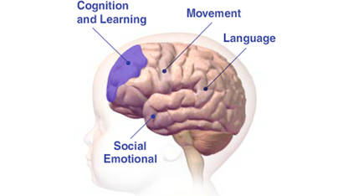
Developmental trauma
Starts at a young age
Is ongoing
Occurs within family relationships
Affects brain development

Slide 5
Trauma challenges beliefs that..
I am safe
I am valuable and good
My world makes sense and is predictable
I can trust people

Slide 6
Schools can provide protective and supportive environment which children and young people may not experience elsewhere.
“Understanding the experience of the abused and neglected child assists us to develop compassion, patience and empathy. It is a key intervention in itself”

Slide 7
Case Study: Sam
Young male student
Lives with his mother and younger sister
Mother very distressed, recent diagnosis of depression, medication prescribed
Ongoing history of domestic violence
Fortnightly visits with father, contact chaotic, father often turns up at house demanding to see Sam
Loves sport and represents school at sporting events

Slide 8
Impact on learning
Easily distracted, unable to concentrate
Preforming below stage outcomes
Difficulty with language skills
Problems solving skills impaired
Difficulty grasping new concepts
Limited memory skills
Unable to plan and organise

Slide 9
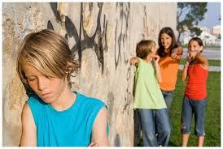
Impact on behaviour
Often non compliant and difficulties following instructions
Misbehaves and quick to get angry
Difficulty making and keeping friends
Can bully other students
Does not cope with changes in school routines
Unable to sit still ,fidgety
Demands constant attention
States ‘I don’t care’

Slide 10
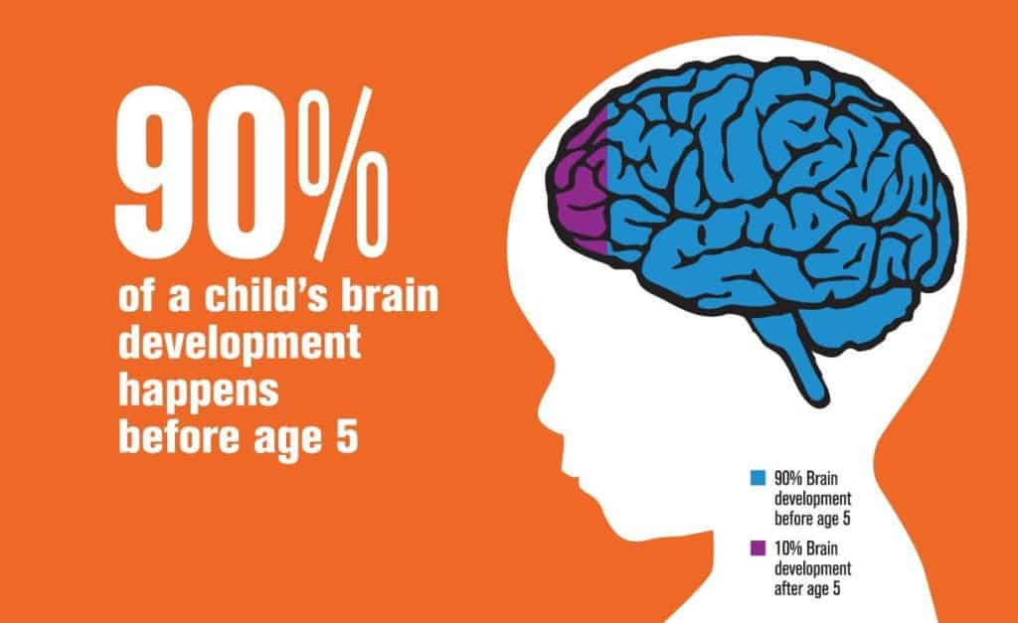
Brain development
The brain is not mature at birth and is changed by experiences
Inadequate and inappropriate social and emotional experiences early in life compromise the development of neural pathways
Significant trauma during development may cause the death of brain cells and the reduction in connection between the cells in the brain

Slide 11
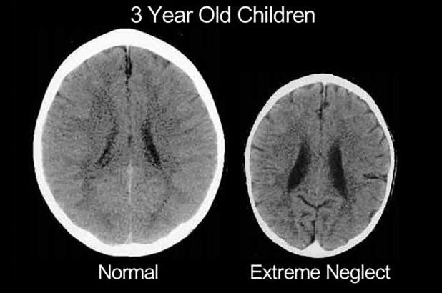

Slide 12
Fear and Safety
Children who experience trauma are often fearful or hypervigilant

Slide 13
How do students like Sam view their world?
I am unlovable
I am unworthy
Others are unavailable
Others are rejecting
Others are unresponsive
The world is unsafe and unpredictable

Slide 14
What is attachment?
It is an emotional bond to other people
It begins as a safe emotional relationship that develops between an infant and a caregiver growing out of ordinary day to day interactions.
It’s the lasting psychological connectedness between human beings

Slide 15
Still face experiment
https://www.youtube.com/watch?v=apzXGEbZht0

Slide 16
Attachment research tells us…
Children tend to impose previous patterns on new relationships especially when faced with a stressful situation
However the capacity to form new safe and secure relationships is always possible

Slide 17
Is not easy…
Working with students who have experience trauma and disruption to attachment can be confronting and challenging
The behaviour exhibited may be confusing with students presenting unreasonable and on task one minute and aggressive or withdraw and unable to focus the next
Its important to:
Separate the behaviour from the student
Not view their actions as a personal attack
Manage your own reaction and responses

Slide 18
What helps in the classroom?
Connect and develop a positive relationship
Maintain structure and consistency
Sensitively offer help eg ‘I see you may need help with….’
Use time in and not time out
Use consequences not punishment
Use visual support
Identify any necessary social skills and teach them.
Structure choices to enable students to understand that they can choose to remain in control
Help students to name their feelings by giving them possible interpretations of their underlying feelings
Acknowledge good decisions and choices
Support parents and carers
Maintain your role as a teacher (boundaries)

Slide 19
This approach helps students to:
Understand how their feelings and thoughts affect their behaviour
Become less scared of their negative emotions
Improves their capacity to contain their emotions

Slide 20
How to be a positive support ?
Be firm
Be predictable
Be compassionate
Be truthful
And plan for adjustments to meet the needs of the child

Slide 21
Concerned about a young person?
Report your concerns to your principal
The mandatory reporter guide can assist you to determine what to
http://reporter.childstory.nsw.gov.au/s/
Suspected risk of significant harm-report to child protection helpline 1321 11
If you are uncertain regarding risk threshold contact the child wellbeing unit on 92699400

Slide 22
Employee assistance program (EAP)
EAP is an independent ,confidential and free counselling service
It can be used for personal or work-related problems
It provides 3 hrs of free counselling sessions in any consecutive 2 year calendar period
For an appointment call 1300 360 364

Slide 23
AUSLAN Auslan (Australian Sign Language) is the language used by the Australian Deaf community

Slide 24
Why learn Auslan?
To communicate with a Deaf friend, family member or colleague
Learn new skills – especially useful in teaching, social work and human services environments
Prepare for life with a Deaf newborn
Develop an interest in another language

Slide 25
.
Sign languages are known as visual-gestural languages. This means movements of the hands and body are made in the space in front of a signer and seen by the person they are communicating with.
The grammar of sign language perfectly meets the needs of deaf people who rely on vision for communication

Slide 26
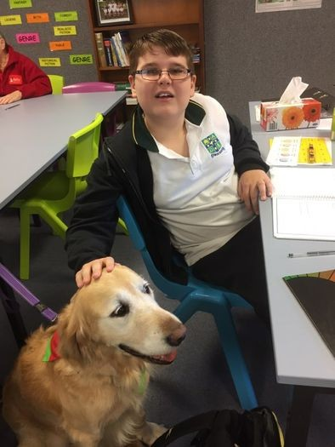
THERAPY DOGS IN SCHOOLS
Therapy dogs decrease anxiety and stress in students, and improve school attendance?

Slide 27
Benefits of therapy dogs at school
Teach students empathy and appropriate interpersonal skills
help individuals develop social skills
be soothing and the presence of animals can more quickly build rapport between the professional and client, and
improve individual's skills to pick up social cues imperative to human relationships..
to support children with social and emotional learning needs, which in turn can assist with literacy development.

Slide 28
Benefits of therapy dogs at school Continued …
.
increase in school attendance
gains in confidence
decreases in learner anxiety behaviours resulting in improved learning outcomes, such as increases in reading and writing levels
positive changes towards learning and improved motivation, and
enhanced relationships with peers and teachers due to experiencing trust and unconditional love from a therapy dog. This in turn helps students learn how to express their feelings and enter into more trusting relationships

Slide 29
The End
Therapy dogs helps students learn how to express their feelings and enter into more trusting relationships

Slide 30
Benefits of therapy dogs at school
More recently, therapy dogs are being used as a form of engagement with students at school and university.
A recent report highlighted children working with therapy dogs experienced increased motivation for learning, resulting in improved outcomes

