Slide 1
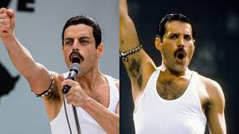
Queen, Live Aid 1985

Slide 2
2018
Improved
New
Stop doing
Positive
Refined
Excelled
Additional

Slide 3
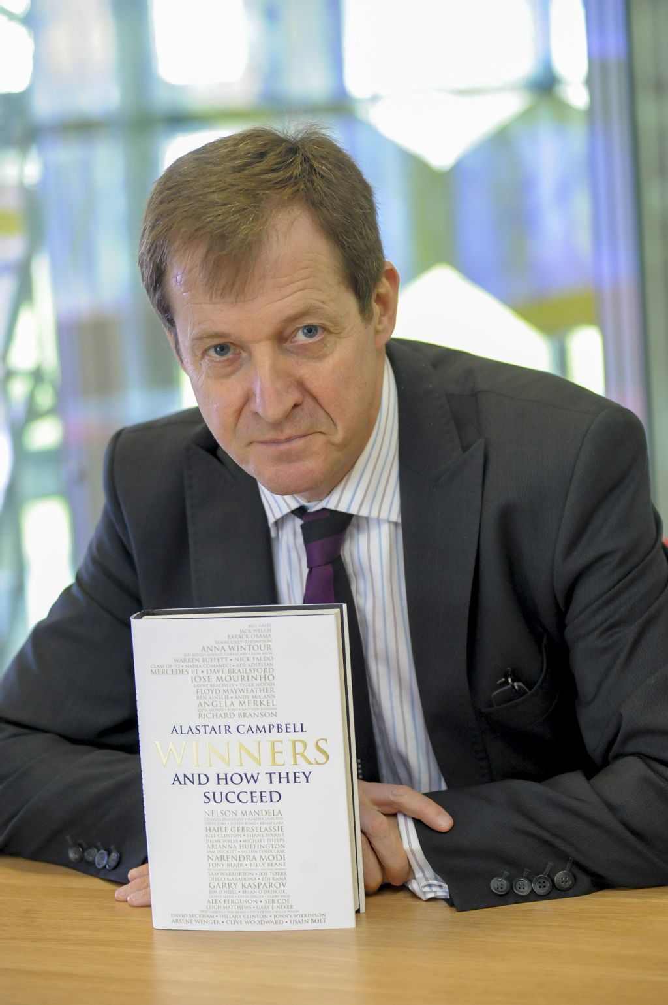

Slide 4
Culture
Every school you walk into feels slightly different, that is because of its culture, which penetrates walls and stairs and ceilings.
Culture transcends individuals within the team and so upholds the values. -Alastair Campbell

Slide 5
The Holy Trinity
Strategy
Leadership
Teamship

Slide 6
Strategy
Strategy is the place to have arguments , not to avoid them.
Strategy is a team game
Strategy is about action, not theory
The best strategies are consistent, but they have to be flexible to adapt.

Slide 7
Leadership
A leader never stops learning, never stops teaching , never stops looking to the future.
- Bill Clinton

Slide 8
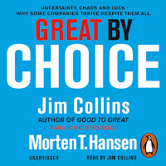
Leaders
An entrenched myth that great leaders are always risk seeking visionaries.
Actually the best leaders ..they observed what worked, figured out why it worked and built upon proven foundations.
- Jim Collins…Great by Choice

Slide 9
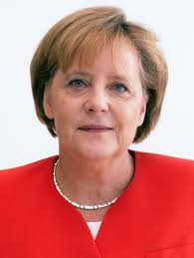
Angela Merkel
She is a winner, three federal elections
Respected and liked by peers
Places pragmatism ahead of grand gestures
Values political and administrative
competence above bold
statements about changing
the world.
Age of Merkel, there is a dignity
to her.

Slide 10
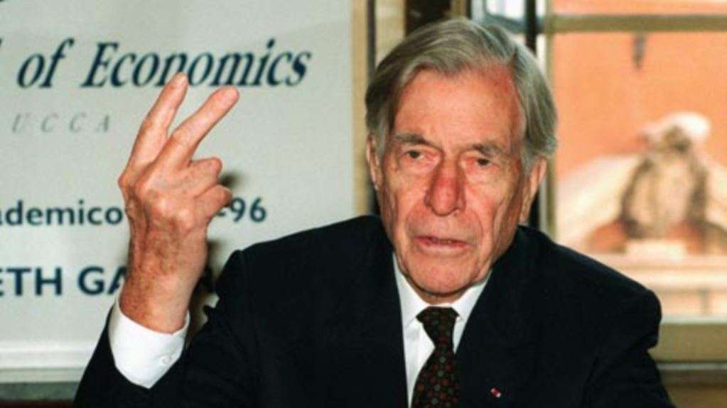
Single Minded Leader
All the great leaders have one characteristic in common: it was the willingness to confront unequivocally the major anxiety of their people in their time. - J.K. Galbraith

Slide 11
Leader Responsibility
I believe as well, a leader can be a fantastic person who can influence other people’s lives in a positive way. Therefore he/she has a great responsibility.
- Arsene Wenger

Slide 12
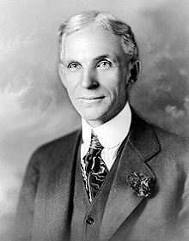
Teamship
Coming together is a beginning, keeping together is progress, working together is success
-Henry Ford

Slide 13
Leaders, Warriors, Talent
Leaders set the direction
Warriors make the trains run on time
Talent makes the difference.
Not every team player has to be a star.

Slide 14
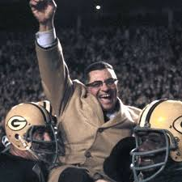
Teams
Individual commitment to a group effort – that is what makes a team work , a company , a society , a civilisation.
-Vince Lombardi

Slide 15
Inside outsiders
Every team needs an inside outsider
Look outside your team
Talk, trust , negotiate

Slide 16
Managing the Talent
There are two types of players …
A…the players who bring what they have to the team and make a good team.
B…the players who use the team to make themselves look great.

Slide 17
Managing the talent
Two types of team members …
….Energy sappers and Energisers
Only the person who isn’t rowing
has time to rock the boat.
-Burnley Football Club.

Slide 18
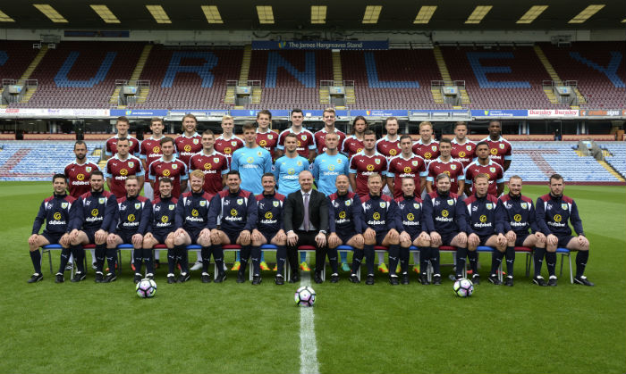
Team building to teamship
In a real team , the instinct for the individual self promotion is realised through the pursuit of the team goal.
-Burnley Football Club.

Slide 19
Team Building
The effective team has good leadership, a strong and shared sense of strategy and objectives, the resources to deliver them and clarity of individual goals.

Slide 20
Teamship
Teamship is more like the glue that holds the team together
A sense of openness and creativity
A resistance to the blame game
A culture that encourages development , adaptability and endless renewal.

Slide 21
Differentiation and Integration
Differentiation
A process where organisations allocate people and resources to a task and establish relationships in order to achieve goals.
Integration
Is the process of coordinating tasks, people and functions to achieve unity of effort...getting everyone to pull in the same direction…on the same page.
The result of effective leadership.

Slide 22
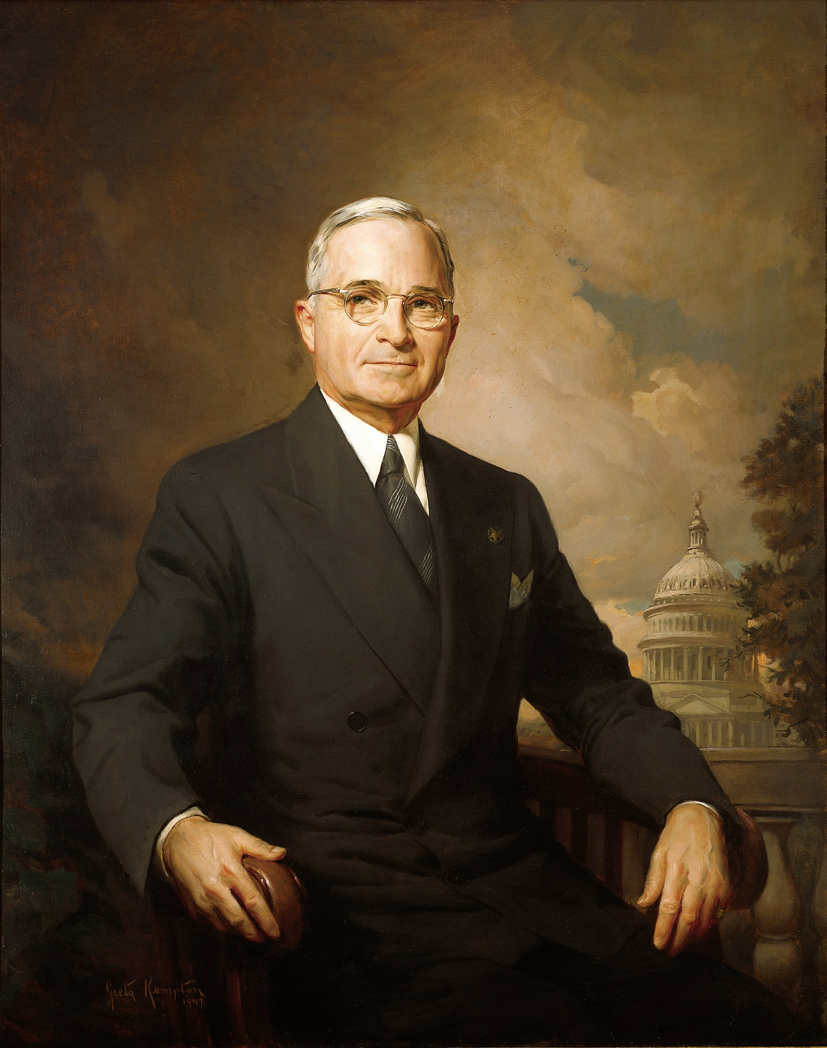
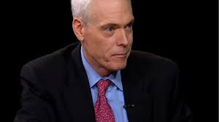
Teams
A team will achieve more if nobody
cares who gets the credit.
-Harry Truman.
We should only do things that we can get passionate about .
-Jim Collins ..Good to Great

Slide 23
A wining team is full of good leaders. You meet them behind shop counters , you meet them behind reception desk, speak to them in call centres.
When you meet a real leader at any level in an organisation, you have a fair idea it is well led from the top.
Go to a school, a hospital, a bank , a department store, the first person you meet whether a doorman, a receptionist, or a PA, is the person who will guide you , they become your leader.
How they do their job will tell you something about the quality of the leadership from the top. Leaders must trust their team. The best leaders are the best team players. - Alastair Campbell, Winners

